Slide 1

Surface Book
Lisa/Rose/Emily/Arthur
NIIT

Slide 2



Surface Book
ExceptionalPerformance
The Ultimate Laptop
Ultimate Versatility
Microsoft Advanced Technology
Team:Lisa/Rose/Emily/Arthur

Slide 3
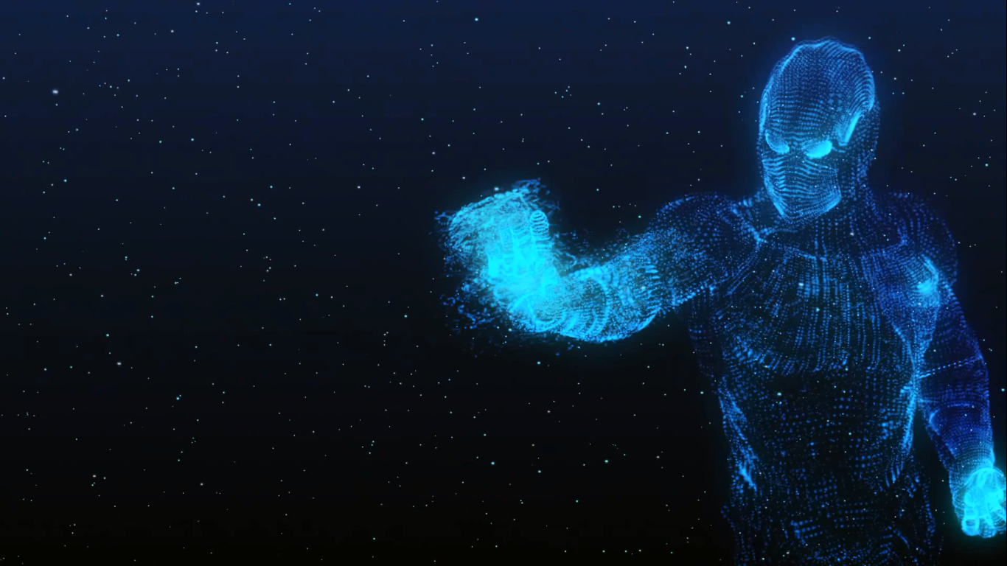
GUIDE
1.The Ultimate Laptop
2.Ultimate Versatility
3.ExceptionalPerformance
4.Microsoft Advanced Technology

Slide 4

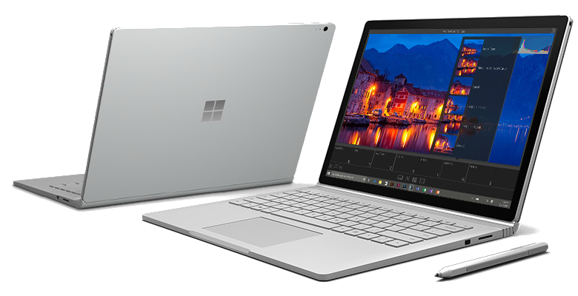
Ultimate
Surface Book

Slide 5
ASSIGNMENT
LISA
MANAGE
ROSE
EMILY
ARTHUR
LOGIN&REGISTER
PRODUCTS
FEEDBACK

Slide 6
REGISTER&ADMIN-ROSE
REGISTER
ADMIN
NAME
ADMIN
PASSWORD
123123
...
...

Slide 7
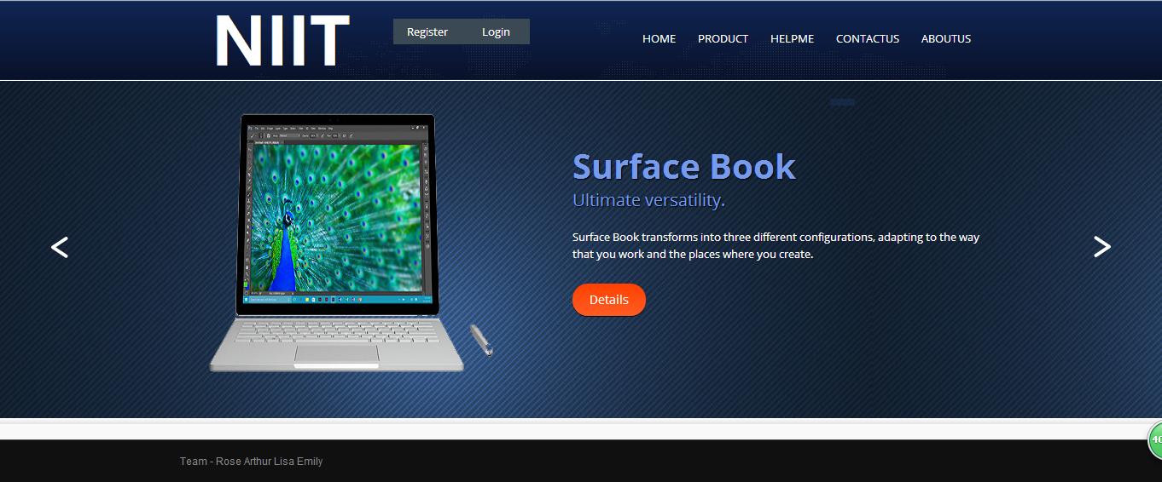

Slide 8
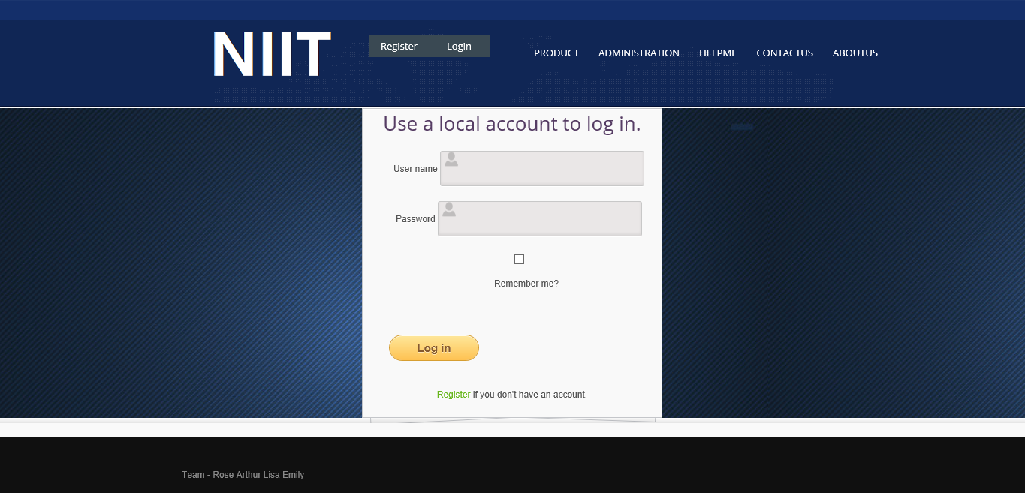

Slide 9
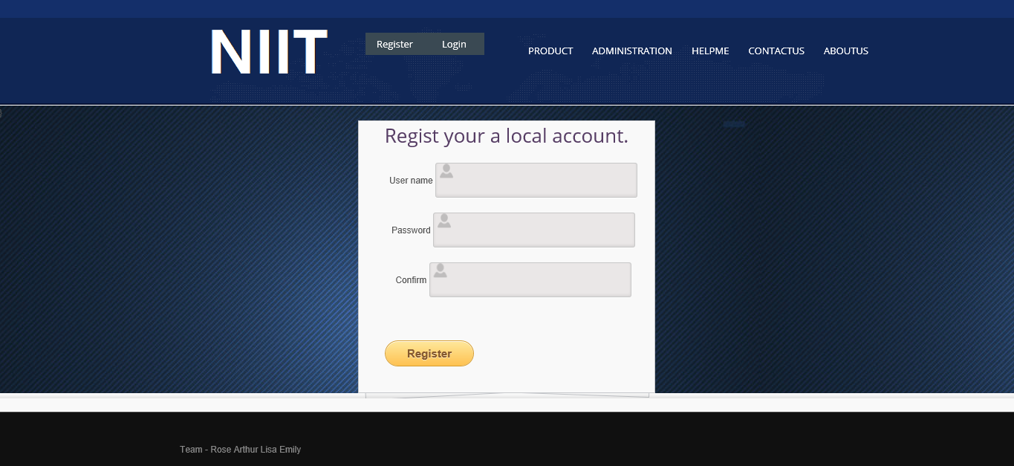

Slide 10
CODE SNIPPET-ROSE
<section id="content">
<h2>Regist your a local account.</h2>
@using (Html.BeginForm())
{
@Html.AntiForgeryToken()
@Html.ValidationSummary()
<fieldset>
<ul><li>@Html.LabelFor(m => m.UserName)
@Html.TextBoxFor(m => m.UserName)</li><li>
@Html.LabelFor(m => m.Password)
@Html.PasswordFor(m => m.Password)</li>
<li>
@Html.LabelFor(m => m.ConfirmPassword)
@Html.PasswordFor(m => m.ConfirmPassword)
</li>
</ul>
<input type="submit" value="Register" />
</fieldset>
}
</section>
@section Scripts {
@Scripts.Render("~/bundles/jqueryval")
}

Slide 11
CODE SNIPPET-ROSE
<section id="content">
<h2>Use a local account to log in.</h2>
@using (Html.BeginForm(new { ReturnUrl = ViewBag.ReturnUrl }))
{
@Html.AntiForgeryToken()
@Html.ValidationSummary(true) <fieldset> <ul> <li> @Html.LabelFor(m => m.UserName)
@Html.TextBoxFor(m => m.UserName)
@Html.ValidationMessageFor(m => m.UserName) </li> <li>
@Html.LabelFor(m => m.Password)
@Html.PasswordFor(m => m.Password)
@Html.ValidationMessageFor(m => m.Password) </li> <li>
@Html.CheckBoxFor(m => m.RememberMe)
@Html.LabelFor(m => m.RememberMe, new { @class = "checkbox" })
</li>
</ul>
<input type="submit" value="Log in" />
</fieldset>
<p>
@Html.ActionLink("Register", "Register") if you don't have an account.
</p>
}
</section>

Slide 12
CODE SNIPPET-ROSE
[Authorize]
public ActionResult Index()
{
return View();
}
@if (User.IsInRole("Admin"))
{
@Html.ActionLink("Create New", "Create")
}
@if (User.IsInRole("Admin"))
{
@Html.ActionLink("Edit", "Edit", new { id = item.Id })
@Html.ActionLink("Details", "Details", new { id = item.Id })
@Html.ActionLink("Delete", "Delete", new { id = item.Id })
}
Authentication

Slide 13
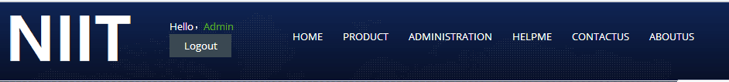
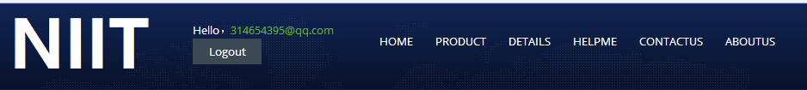
CODE SNIPPET-ROSE
Common users navigation bar is different from Admin

Slide 14
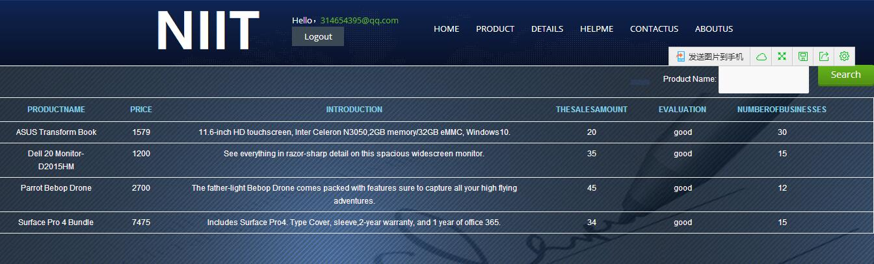
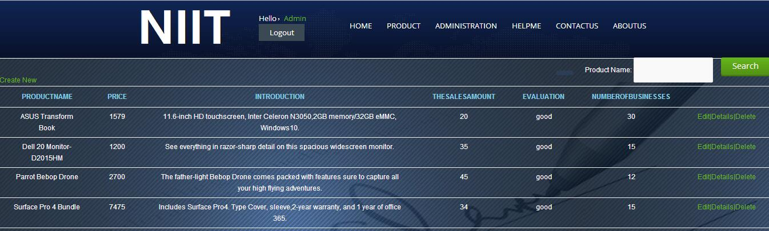
Ordinary users can’t use CRUD.
Admin can use CRUD.

Slide 15
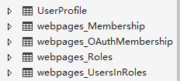
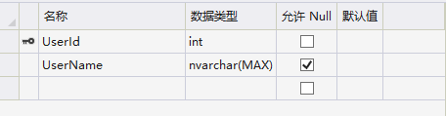
CODE SNIPPET-ROSE
<connectionStrings> <add name="DefaultConnection" connectionString="Data Source=(LocalDb)\v11.0;Initial Catalog=aspnet-SurfaceBook-20160104193219;Integrated Security=SSPI;AttachDBFilename=|DataDirectory|\aspnet-SurfaceBook-20160104193219.mdf" providerName="System.Data.SqlClient" /> <add name="SurfaceBook" connectionString="Data Source=(LocalDb)\v11.0;Initial Catalog=SurfaceBook;Integrated Security=SSPI;AttachDBFilename=|DataDirectory|\SurfaceBook.mdf" providerName="System.Data.SqlClient" /> </connectionStrings>

Slide 16
PRODUCT-EMILY
SURFACE
LUMIA
MICRO
WINDOWS
XBOX

Slide 17
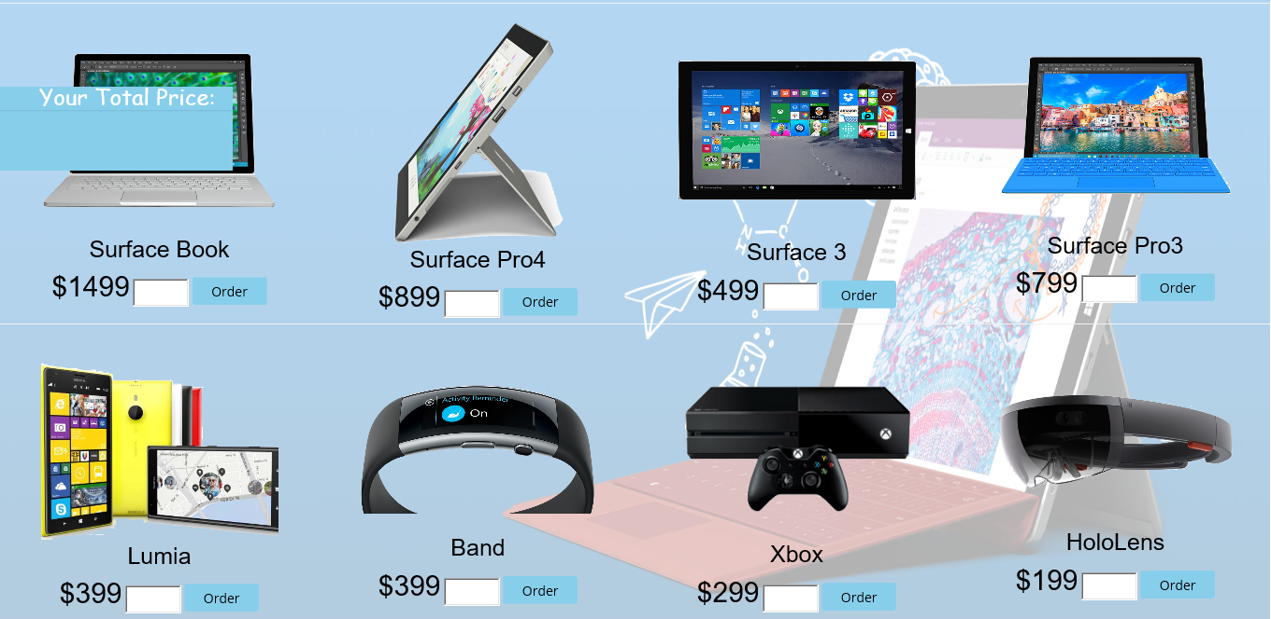
.
The Interface of Products

Slide 18
CODE SNIPPET-Emily
<div style="background-color:white">
<img src="~/image/bbg.jpg" style="position:relative;height:800px;width:1360px; opacity:0.3;z-index:500;"/>
<table style="width:100%;z-index:1000; position:absolute;top:150px;left:0px; padding:0;" border="0">
<tr>
<td>
<input class="btn" name="" type="image" src="~/image/s2.png" onclick="location='surface1'" />
<p style="font-size: 25px; color: black;">Surface Book</p>
<b style="font-size:30px;color:black;">$1499</b>
</td>
.................
</tr>
<tr style="z-index:1000">
<td>
<input class="btn" name="" type="image" src="~/image/l.png" onclick="location='surface5'" />
<p style="font-size: 25px; color: black;">Lumia</p>
<b style="font-size:30px;color:black">$399</b>
</td>
..................
</tr>
</table>
</div>
The Code of Products

Slide 19
CODE SNIPPET-Emily
<script type="text/javascript" src="plugins/jquery-1.8.3.js">
</script>
<script type="text/javascript">
function sum1() {
var price = document.getElementById("price").value;
var num1 = parseInt(document.getElementById("number1").value);
document.getElementById("price").value = parseInt(1499 * num1);
price = document.getElementById("price").value;
return price;
}
function sum2() {
var old1 = sum1();
var price = document.getElementById("price").value;
var num2 = parseInt(document.getElementById("number2").value);
document.getElementById("price").value = parseInt(499 * num2) + parseInt(old1);
price = document.getElementById("price").value;
return price;
}
</script>
The code of total price

Slide 20
CODE SNIPPET-Emily
<input id="number1" type="number" name="quantity" min="0" max="100" spry:default="0"
style="width:60px;height:30px;">
<button onclick="sum1();" style="width:80px;height:30px; background-
color:skyblue;color:black;">Order</button>
<div id="divfix" style="background-color:skyblue; z-index:1000; position:fixed;top:95px;left:0px;
height:90px;width:250px;">
<span style="font-size:24px;color:white;font-family:'Comic Sans MS', cursive;">
&nbsp;&nbsp;&nbsp;&nbsp;&nbsp;&nbsp;Your Total Price:
</span><br /><br />
<input type="text" id="price" style="position:absolute; height:50px;width:250px;left:0px;top:25px;
font-size:24px; border-color:skyblue; font-family:'Comic Sans MS', cursive; background-color:skyblue;
color:white;" />
</div>
Order Button
The area of Price

Slide 21
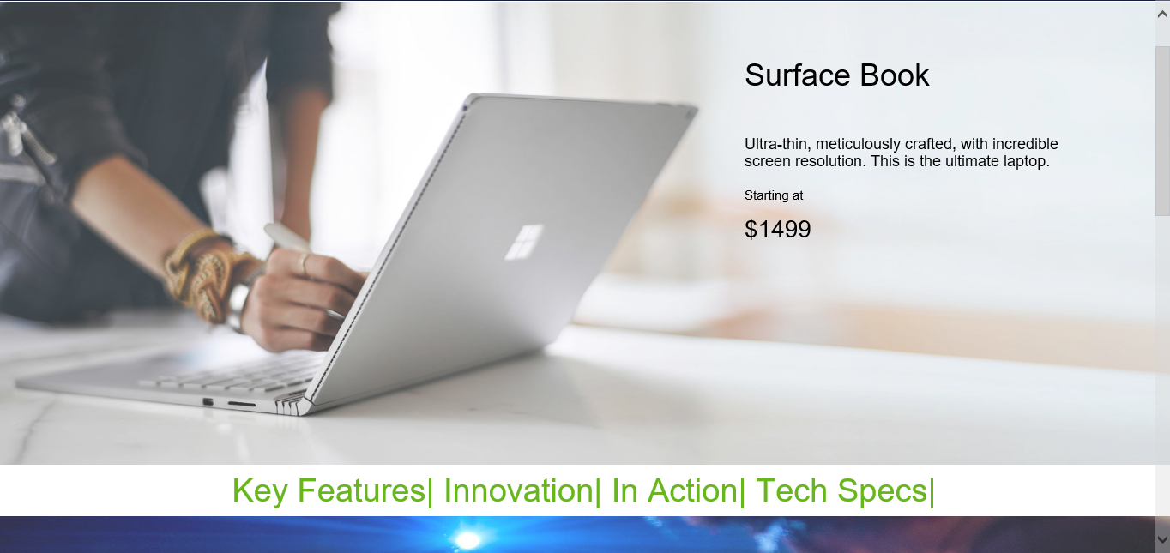

Slide 22
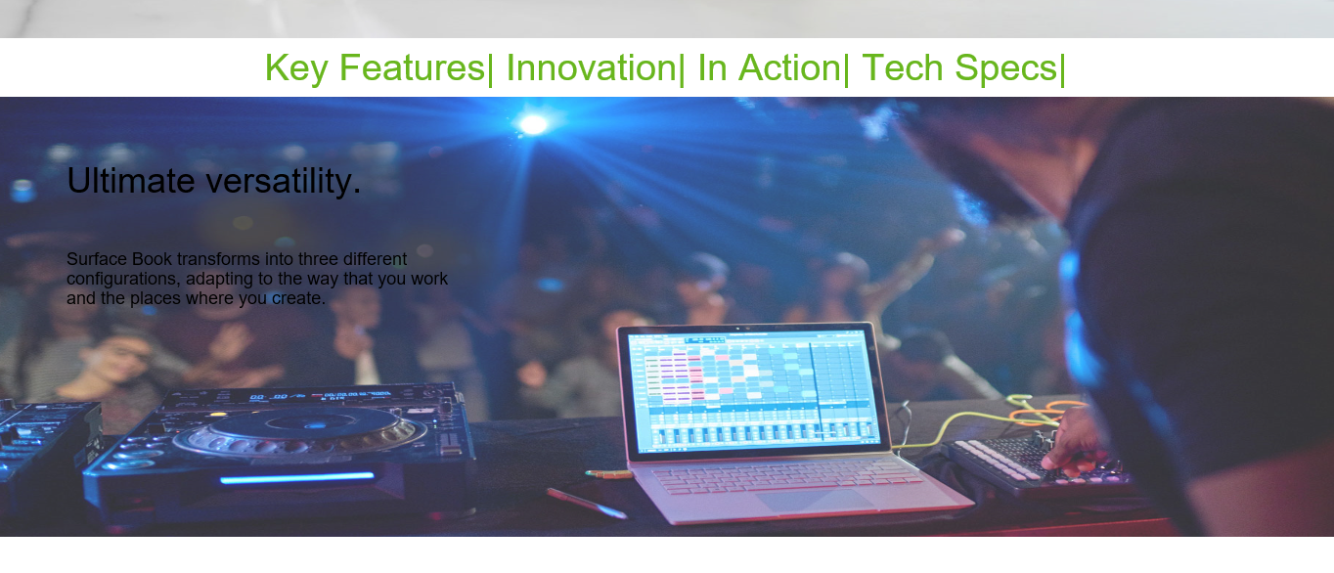

Slide 23
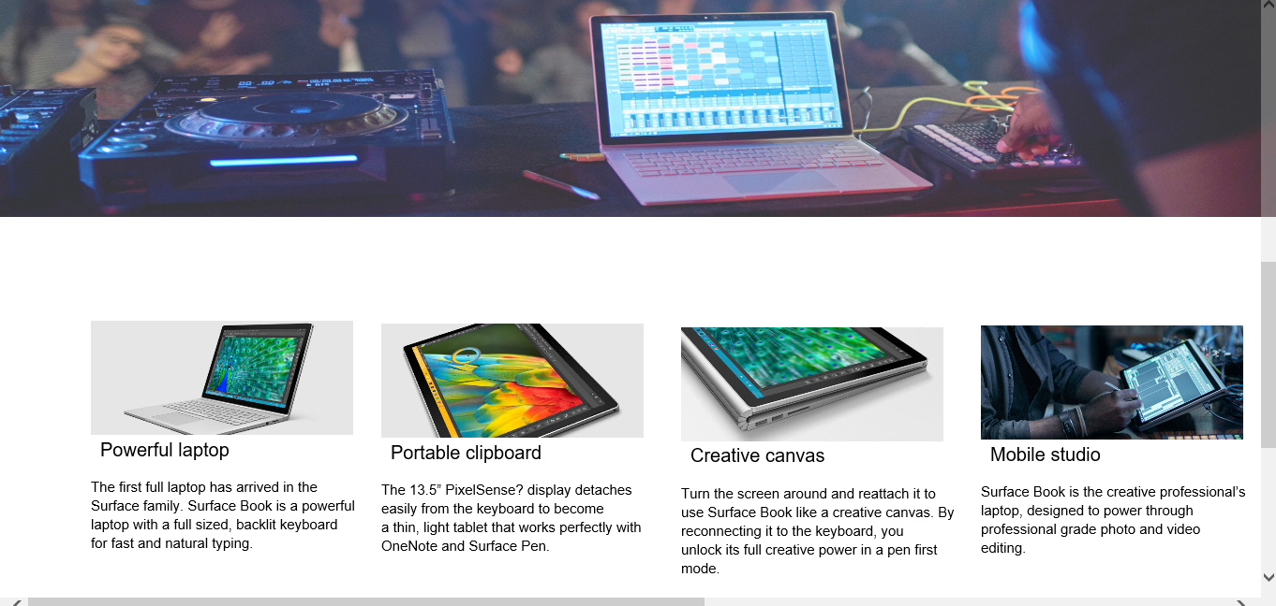

Slide 24
CODE SNIPPET-Emily
<div style="background-color:white">
<div style="height:560px">
<img style="position:relative;width:1450px;height:540px;opacity:0.8;" src="~/image/bg.jpg">
<div style="left:470px;top:270px; position:absolute">
<p style="font-size:36px;color:black;position:relative;right:-400px;top:-100px">Surface Book<p>
<br />
......................
</div>
</div>
<div style="text-align:center;font-size:38px;">
@Html.ActionLink("Key Features|", "Index", "Products")
@Html.ActionLink("Innovation|", "Innovation", "Products")
@Html.ActionLink("In Action|", "Action", "Products")
@Html.ActionLink("Tech Specs|", "Specs", "Products")
</div>
<div>
<video style="width:1350px;min-width:550px;" src="~/video/Surface Book.mp4" autoplay></video>
</div>
The Code of Surface Book

Slide 25
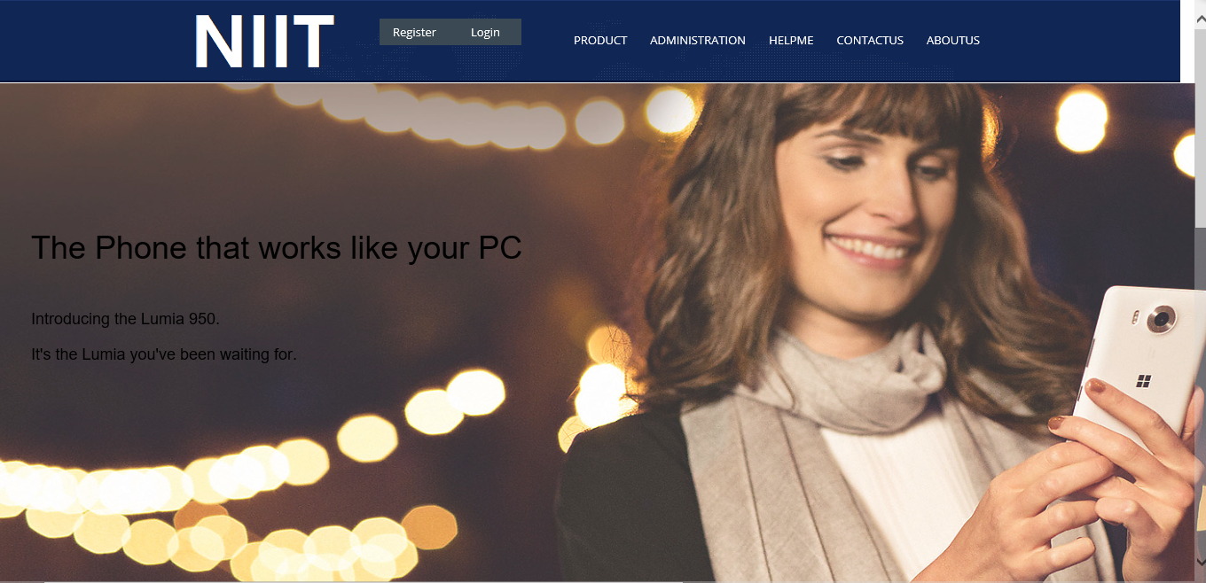

Slide 26
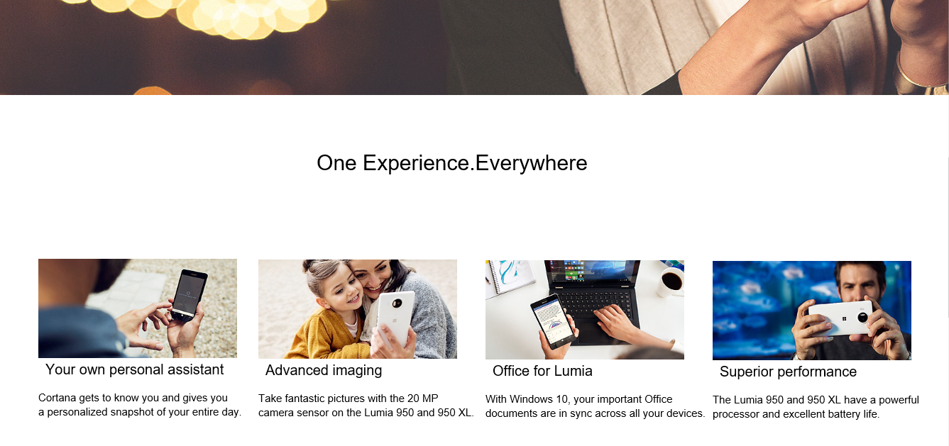

Slide 27
CODE SNIPPET-Emily
<div style="background-color:white;">
<div>
<img style="position:relative;width:1450px;height:660px;opacity:0.8;" src="~/image/2.jpg">
<div style="left:70px;top:270px; position:absolute">
<p style="font-size:36px;color:black">The Phone that works like your PC<p>
<br />
<p style="font-size: 18px; color: black">Introducing the Lumia 950.</p>
<p style="font-size: 18px; color: black">It's the Lumia you've been waiting for.</p>
</div>
</div>
......................
<div style="position:relative;top:-510px;left:1050px">
<input class="ipt" name="" type="image" src="~/image/6.jpg" >
<p style="font-size: 20px; color: black; left: 10px; position: relative">Superior performance</p>
<p style="font-size:15px;position:absolute;color:black">The Lumia 950 and 950 XL have a powerful<br/>
processor and excellent battery life.</p>
</div>
</div>
The Code of Lumia

Slide 28
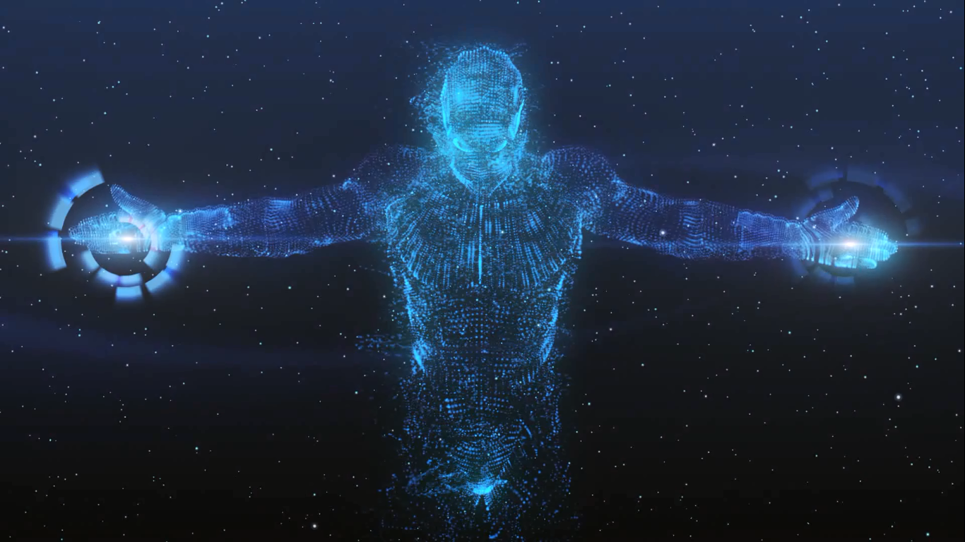
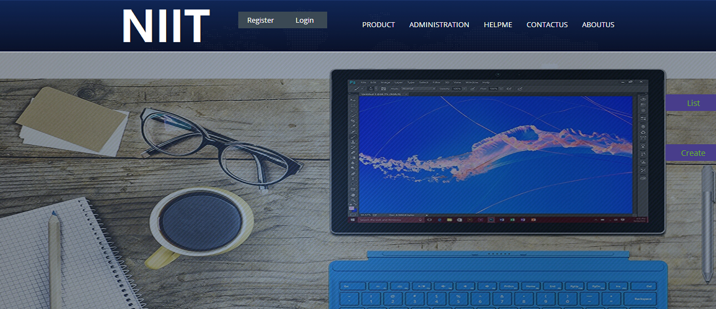

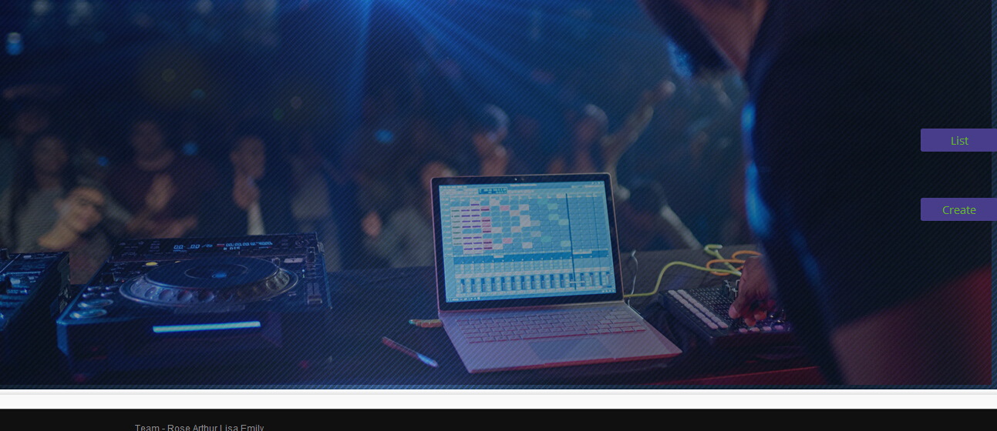
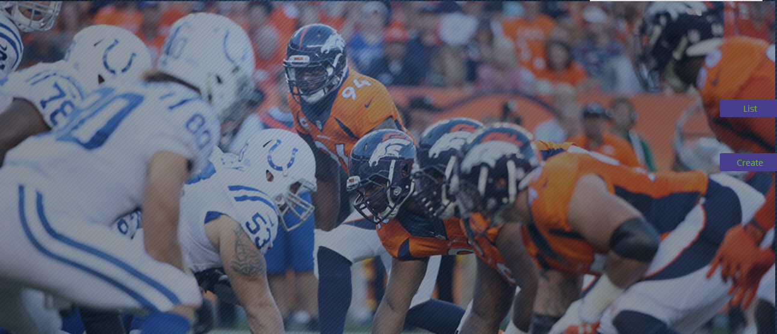
Lisa

Slide 29
Global.asax
Model
Controllers
Web.config

Slide 30
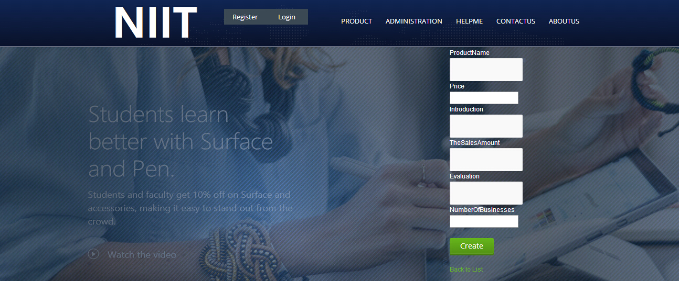
using System.ComponentModel.DataAnnotations;
using System.Data.Entity;
public class Administration
{
public int Id { get; set; }
public string ProductName { get; set; }
public int Price { get; set; }
public string Introduction { get; set; }
public string TheSalesAmount { get; set; }
public string Evaluation{ get; set; }
public int NumberOfBusinesses { get; set; }
}

Slide 31
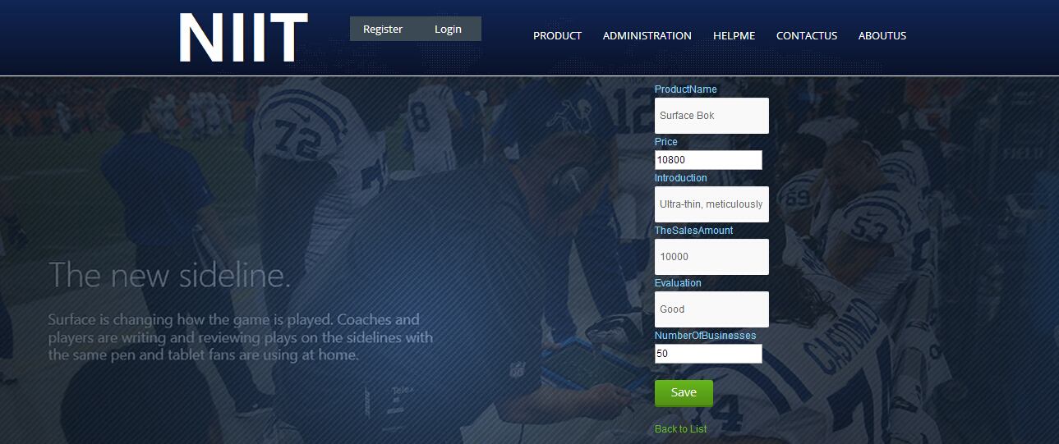
using System.ComponentModel.DataAnnotations; using System.Data.Entity; using SurfaceBook.Models; public class AdministrationDBContext : DbContext { public AdministrationDBContext() : base("SurfaceBook") { } public DbSet<Administration> Administrator { get; set; } }

Slide 32
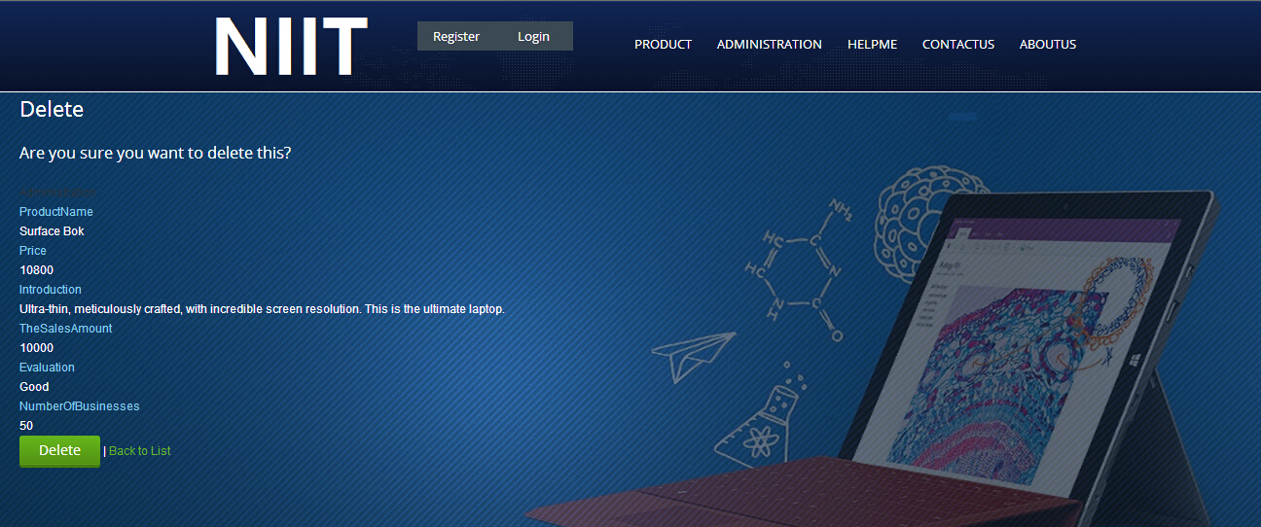
Database.SetInitializer
(newDropCreateDatabaseIfModelChanges
<AdministrationDBContext>());

Slide 33
Model
ModelClass
TheDataContextClass
Contains the read/write operation and the view of MVC controller (Entity Framework)
Administration(SurfaceBook.Models)
AdministrationDBContext(SurfaceBook.Models)

Slide 34
[HttpPost]
[ValidateAntiForgeryToken]
public ActionResult Create(Administration administration)
{
if (ModelState.IsValid)
{
db.Administrator.Add(administration);
db.SaveChanges();
return RedirectToAction("Index");
}
return View(administration);
}

Slide 35
[HttpPost]
[ValidateAntiForgeryToken]
public ActionResult Edit(Administration administration)
{
if (ModelState.IsValid)
{
db.Entry(administration).State = EntityState.Modified;
db.SaveChanges();
return RedirectToAction("Index");
}
return View(administration);
}

Slide 36
public ActionResult Delete(int id = 0)
{
Administration administration = db.Administrator.Find(id);
if (administration == null)
{
return HttpNotFound();
}
return View(administration);
}

Slide 37
[HttpPost, ActionName("Delete")]
[ValidateAntiForgeryToken]
public ActionResult DeleteConfirmed(int id)
{
Administration administration = db.Administrator.Find(id);
db.Administrator.Remove(administration);
db.SaveChanges();
return RedirectToAction("Index");
}
protected override void Dispose(bool disposing)
{
db.Dispose();
base.Dispose(disposing);
}

Slide 38
FEEDBACK&CONTACT-ARTHUR
CONTACT
ASSISTANCE
FEEDBACK
CONTACT US
ABOUTUS
DO YOU HAVE ANY QUESTIONS
CLICK ME TO HELP
WE ARE PROFESSIONAL
ONLINE STORE

Slide 39
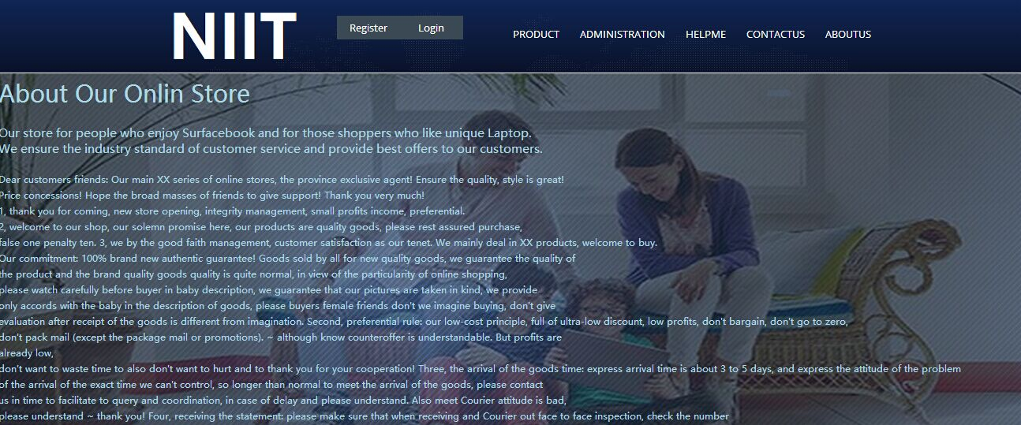

Slide 40
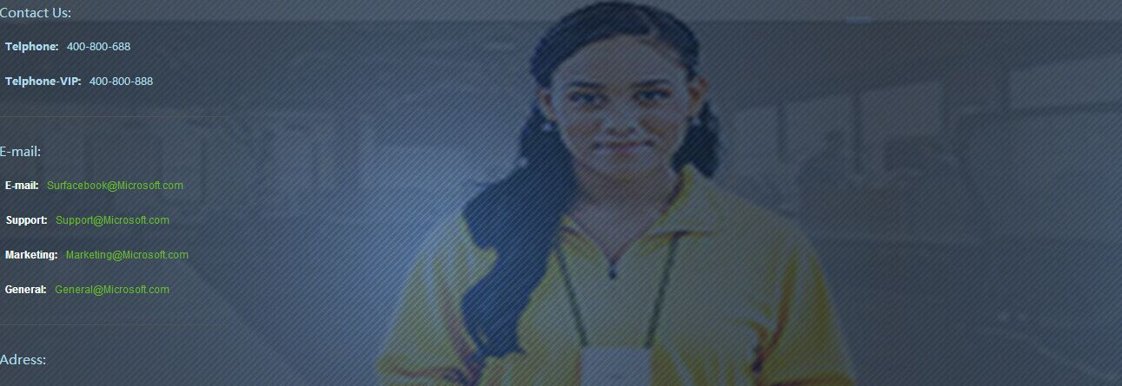

Slide 41
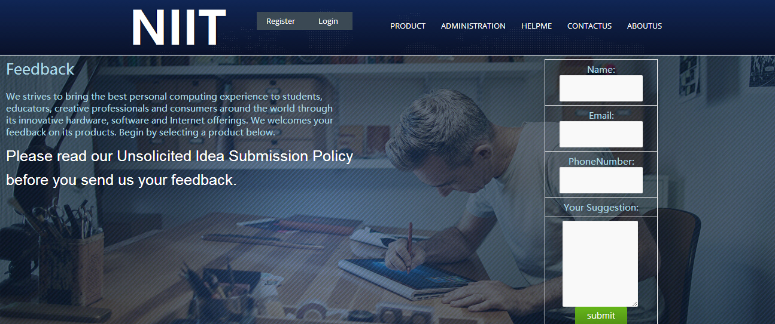

Slide 42
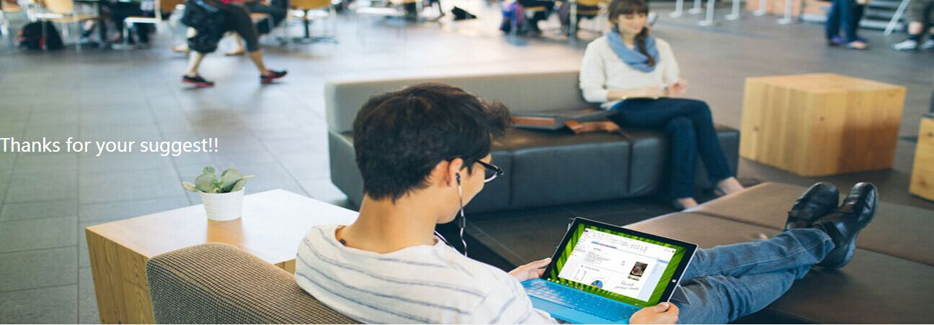

Slide 43
CODE SNIPPET HELP-ARTHUR
<body> <h2 style="font-size:25px;color:lightblue;font-family:'Microsoft YaHei'">Feedback</h2>
<p style="font-size:15px;color:lightblue;font-family:'Microsoft YaHei'">
We strives to bring the best personal computing experience to students, <br />
educators, creative professionals and consumers around the world through <br />
its innovative hardware, software and Internet offerings. We welcomes your <br />
feedback on its products. Begin by selecting a product below.
</p><br /> <table style="width:30%; "> <tr>
<td style="font-size: 15px; color: lightblue; font-family: 'Microsoft YaHei'"> Name:
<input id="Text1" type="text" /> </td> </tr> <tr>
<td style="font-size: 15px; color: lightblue; font-family: 'Microsoft YaHei'">
Email:<input id="Text2" type="text" /> </td> </tr> <tr>
<td style="font-size: 15px; color: lightblue; font-family: 'Microsoft YaHei'"> PhoneNumber:
<input id="Text4" type="text" /> </td> </tr> <tr> <td style="font-size: 15px; color: lightblue; font-family: 'Microsoft YaHei'"> Your Suggestion: </td>
</tr> <tr> <td> <textarea id="TextArea1" rows="6" cols="5"></textarea>
<br /> <input style="background-color:dodgerblue;" id="Submit1" type="submit" value="submit" onclick="location='Thanks'" /><br /> </td> </tr> </table>
<p style="font-size:25px;color:red;font-family:'Microsoft YaHei'">Please read our Unsolicited Idea Submission Policy before you send us your feedback.</p>
</body>
</html>

Slide 44
CODE SNIPPET ABOUT-ARTHUR
Dear customers friends:
Our main XX series of online stores, the province exclusive agent! Ensure the quality, style is great!<br />
Price concessions! Hope the broad masses of friends to give support! Thank you very much!<br />
1, thank you for coming, new store opening, integrity management, small profits income, preferential.<br />
2, welcome to our shop, our solemn promise here, our products are quality goods, please rest assured purchase, <br />
false one penalty ten.
3, we by the good faith management, customer satisfaction as our tenet. We mainly deal in XX products, welcome to buy.<br />
Our commitment: 100% brand new authentic guarantee! Goods sold by all for new quality goods, we guarantee the quality of<br />
the product and the brand quality goods quality is quite normal, in view of the particularity of online shopping,<br />
please understand ~ thank you!
Four, receiving the statement: please make sure that when receiving and Courier out face to face
good can be accepted, if others are signed, we also as I sign for it, to sign for them later have what problem, whose<br />
responsibility is difficult to determine, so to sign the approval items in good condition, hope everybody buyers carefully check,<br />
thank you!

Slide 45
THANKS

